Slide 1




Harjas Uday
Home
Service
About Us
Contact
FILLBOT
TEAM HARJAS UDAY
Lovish Rawat 22104005
Vibhor Gupta 22104014
Chirag Rawat 22104015
Hardik Sethi 22104023
Lavanya Arora 22105038

Slide 2


Studio Shodwe
Home
Service
About Us
Contact
OUR PROBLEM STATEMENT
Human Resources (HR) teams are often inundated with a high volume of resumes, making the manual review process tedious and time-consuming.
This approach not only increases the risk of human error but also leads to potential oversight of qualified candidates. The lack of automation in the initial screening phase hinders efficiency and productivity, necessitating a streamlined solution.
By automating the resume screening and candidate data submission process, we can significantly reduce the time spent on manual tasks, improve accuracy, and maintain an organized audit trail for future reference.

Slide 3
Studio Shodwe
Home
Service
About Us
Contact
OUR OBJECTIVE
To develop an automated bot that streamlines the recruitment process by efficiently screening resumes and inputting candidate details into a Microsoft Form.
This solution aims to enhance the productivity of HR teams by reducing manual workload, minimizing errors, and ensuring accurate record-keeping of all processed applications.

Slide 4
Studio Shodwe
Home
Service
About Us
Contact
PROJECT OVERVIEW
The solution leverages Robotic Process Automation (RPA) to streamline the recruitment workflow.
Email Integration: The bot retrieves emails with the subject line “STGi | New Hire(s)” to identify incoming resumes.
PDF Processing: It downloads PDF attachments and utilizes Optical Character Recognition (OCR) to extract key candidate details such as name, education, skills, and years of experience.
Form Automation: Extracted data is automatically populated into a designated Microsoft Form, eliminating the need for manual input.
Audit Trail: The bot generates a daily audit report summarizing all processed applications, which is emailed to stakeholders for review.
Error Management: Robust error handling mechanisms ensure smooth operation, providing logs for troubleshooting and auditing purposes.
This automated solution aims to significantly reduce the time spent on initial resume screenings, improve accuracy, and enhance overall recruitment efficiency.

Slide 5

Studio Shodwe
Home
Service
About Us
Contact
TECHNOLOGY USED
echnol
Robotic Process Automation (RPA) Platform: UiPath
Utilized for designing and implementing the automation workflows, including email retrieval, data extraction, and form submission.
Microsoft Forms:
For creating structured forms to capture candidate details and facilitate data submission.
Microsoft Excel:
For report generation, and maintaining logs of processed submissions.
Email Platforms: Gmail:
For fetching and filtering emails containing the resumes.
01
02
03

Slide 6
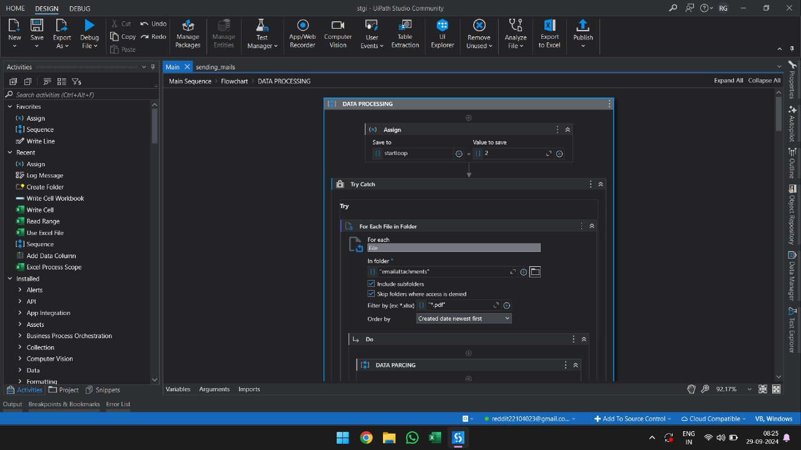
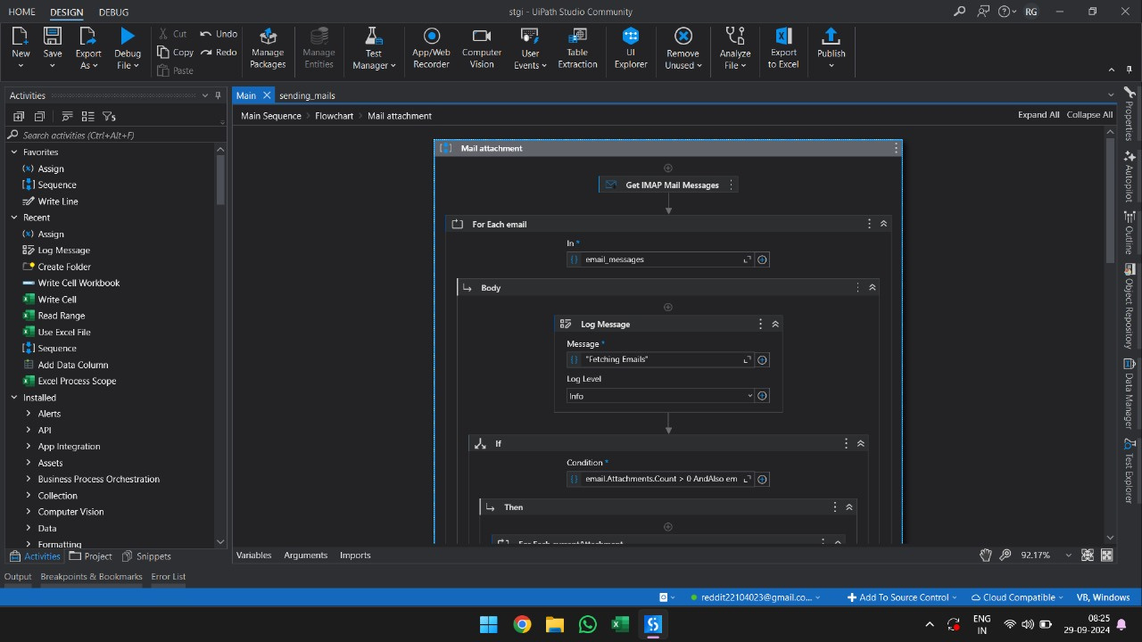
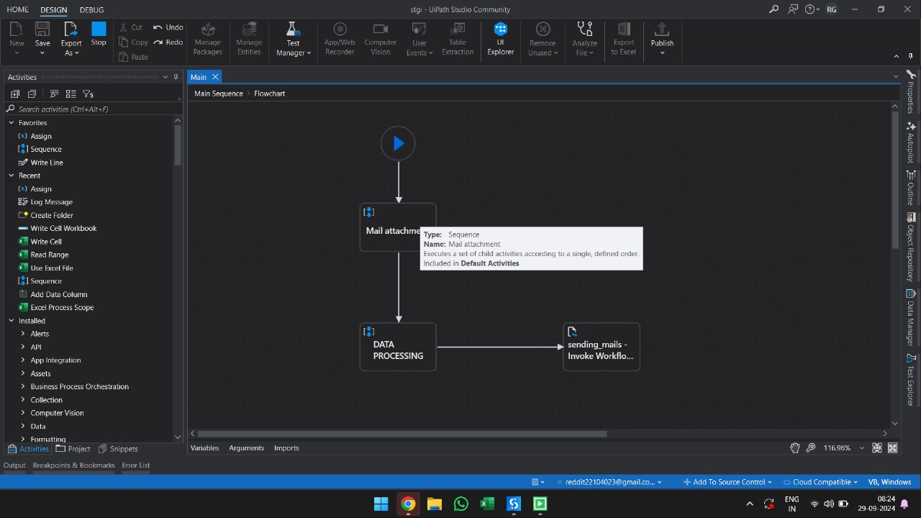
Studio Shodwe
Home
Service
About Us
Contact
WORKFLOW

Slide 7
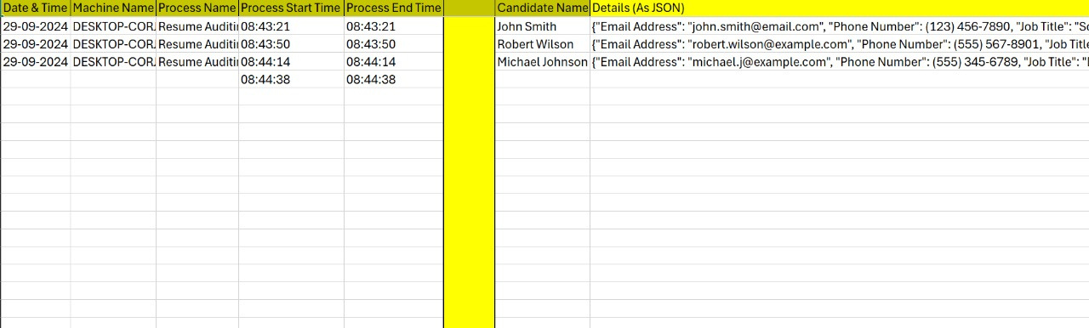
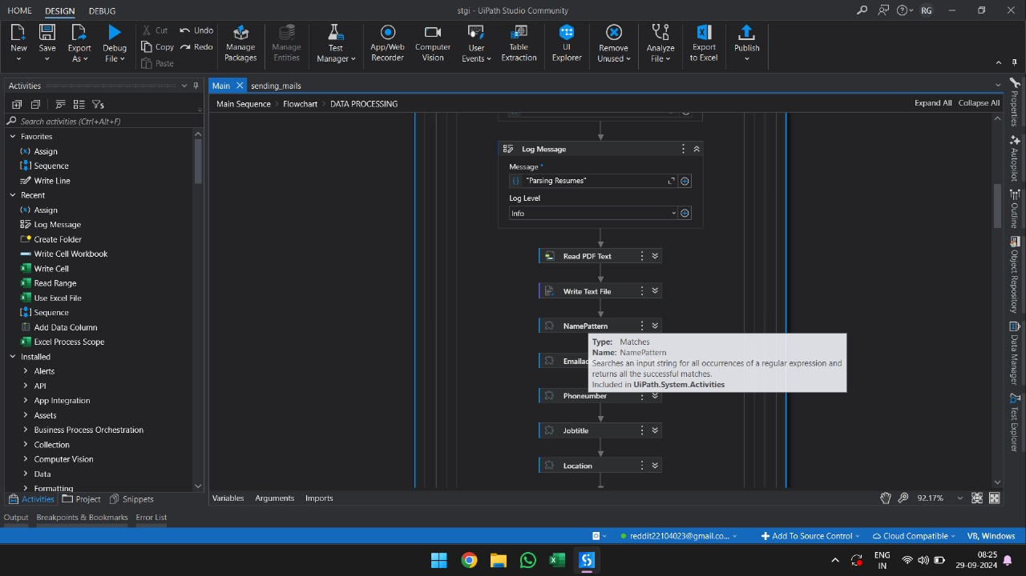
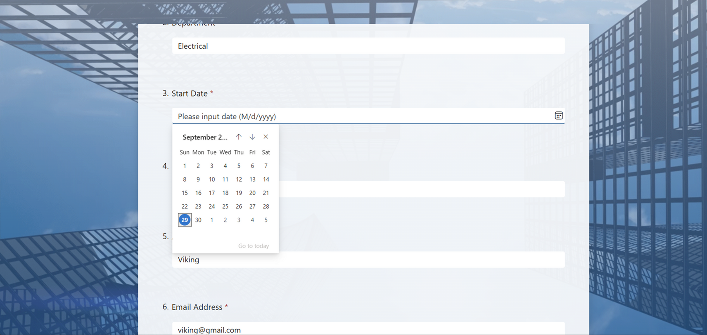
Studio Shodwe
Home
Service
About Us
Contact
WORKFLOW

Slide 8

Studio Shodwe
Home
Service
About Us
Contact
CHALLENGES FACED
01
Authentication Setup: Configuring Gmail with IMAP required enabling two-factor authentication and generating an application-specific password to establish a secure connection.
02
Form Error Handling: Faced persistent issues with the date input field while filling the form, which took considerable time to resolve.
03
Date Format Conversion: Encountered difficulties in converting the date to the required format for the form, which caused delays in completing the task.

Slide 9

Studio Shodwe
Home
Service
About Us
Contact
IMPACT
01
Increased Efficiency:
Impact: Automating resume screening reduces the time spent on manual reviews, allowing HR teams to focus on higher-value tasks like candidate engagement.
Enhanced Accuracy:
Impact: Minimizing human error in data extraction improves candidate information accuracy, leading to better-informed hiring decisions.
Streamlined Workflow:
Impact: Automating email retrieval, data extraction, and form submission creates a seamless workflow, accelerating recruitment and reducing bottlenecks.
Scalability:
Impact: The solution easily scales to handle more resumes without increasing HR workload, making it adaptable to growing recruitment needs.
02
03
04

Slide 10

Studio Shodwe
Home
Service
About Us
Contact
FUTURE SCOPE
01
Integration with ATS:
Enhancement: Link with ATS for improved data management and tracking.
Multi-Format Support:
Enhancement: Support various file formats (e.g., Word, Excel) for flexibility.
User Interface Improvements:
Enhancement: Create a user-friendly dashboard for efficient monitoring and reporting.
Globalization:
Enhancement: Enable multi-language support to address diverse recruitment needs.
02
03
04

Slide 11

Studio Shodwe
Home
Service
About Us
Contact
CONCLUSION
Our automated resume screening and submission system significantly enhances the recruitment process for HR teams by improving efficiency, accuracy, and scalability.
By leveraging RPA and OCR technologies, we streamline the workflow, reduce manual errors, and create comprehensive audit trails.
As we look to the future, further integrations, multi-format support, and user-friendly enhancements will position our solution as a vital tool in modern recruitment practices.
Ultimately, this project not only addresses current challenges but also paves the way for more effective and data-driven hiring strategies.

Slide 12
Studio Shodwe
Home
Service
About Us
Contact
THANK YOU

